Slide 1
Ideas Worth Sharing IRON Chef Challenge

Slide 2
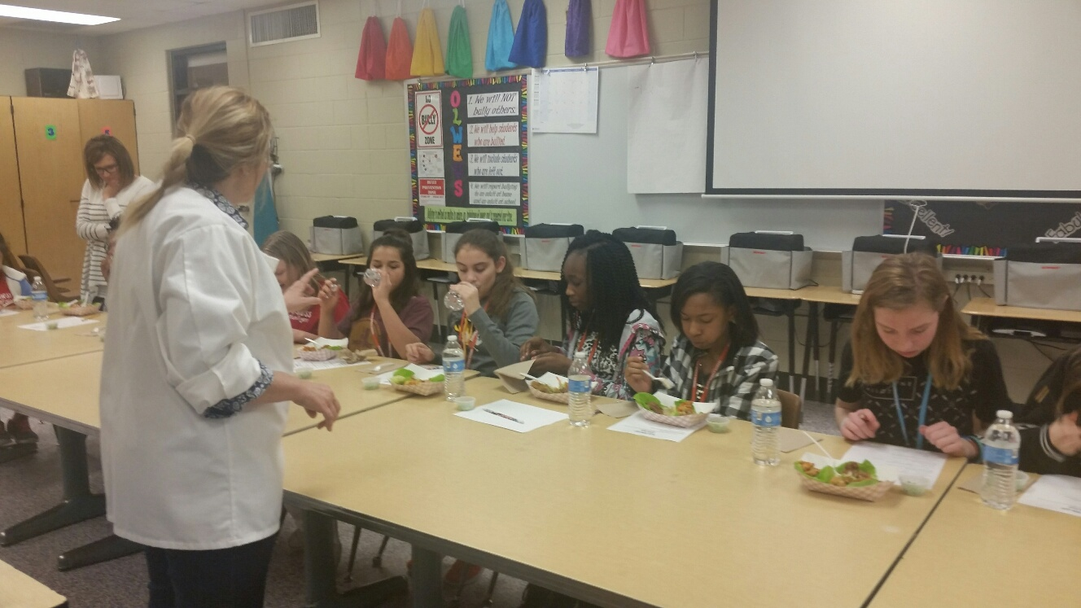
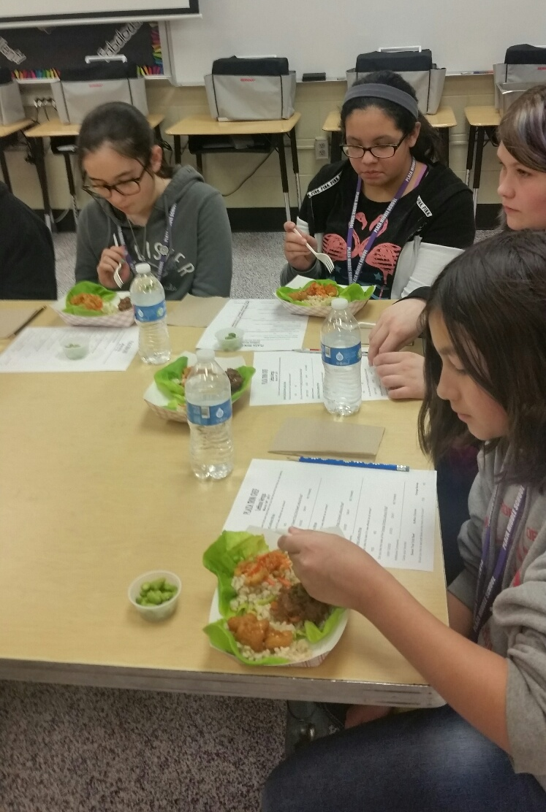
IRON Chef Challenge
Chef creates in front of students
Introduce new foods
Watch how it’s made
See, Smell, Taste, Rate
Winning recipe is menued
District Value/Benefit
Spotlights Quality Ingredients
Students Feel Empowered
Program Branding
Media Opportunity

Slide 3
IRON CHEF “HOW To’s”
Sweet Chili Beef Lettuce Wrap
JTM Sous Vide Beef
Roland Sweet Thai Chili Sauce
Orange Shrimp Lettuce Wrap
Viking Popcorn Shrimp
JTM Hunan Style Orange Sauce
Buffalo Chicken Lettuce Wrap
Yang’s Buffalo Hot Ling’s Chicken
Butter Lettuce Cups
MG Honors Farms
Local, Hydroponically Grown
Speed Scratch
Ingredients
Utilize Speed Scratch
Partner with Vendors
Enlist corporate or local chefs
Purchase “Local” when possible
Bon Appetite!

